Slide 1


Slide 2

Business Etiquette - 4

Slide 3

GATHERING INFORMATION

Slide 4

What is Information Gathering
Information gathering is a systematic approach to collecting, organizing, and analyzing data that incorporates planning, quality control, and stakeholder involvement.
It is fundamental for informed decision-making and comprehensive research.
Information is the backbone of decision-making. Effective Information gathering is crucial for staying competitive.

Slide 5
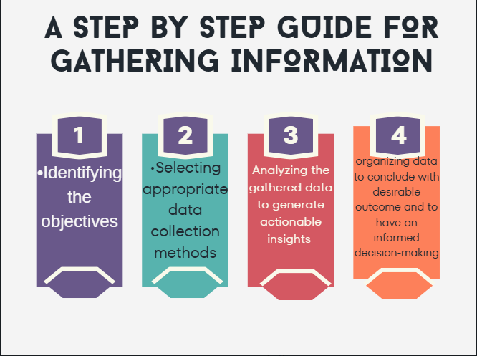

Slide 6
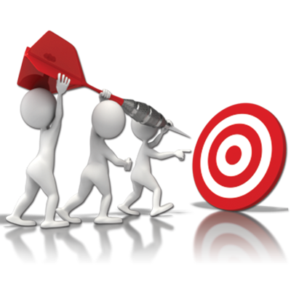
Identifying Objectives and Defining Scope
The first step on this journey is establishing precise objectives and defining the scope.
Clear objectives facilitate improved decision-making and enhance productivity, engagement, and communication.
Defining the scope involves documenting specific goals, deliverables, and tasks.
It sets boundaries, identifies necessary resources, and facilitates the creation of a Business schedule.

Slide 7
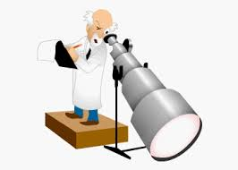
Selecting Appropriate Data Collection Methods
The next ensuing step involves selecting suitable data collection methods. There are several techniques for data collection,including,Surveys,Interviews,Observations,Focus groups, Experiments,Secondary data analysis
For instance, surveys are ideal when the objective is to reach specific individuals or locations and draw insights from a specific group.

Slide 8
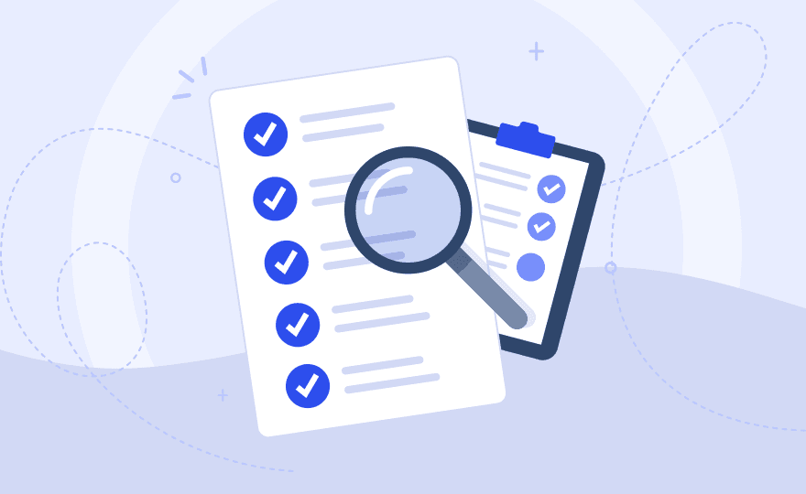
Selecting Appropriate Data Collection Methods
On the other hand, interviews are most suitable when researchers aim to acquire qualitative data and understand the thoughts and behaviors of individuals.
The choice of data collection method significantly influences the quality of the collected data and the insights derived from it.

Slide 9

Data Actionable Insights
1. Define Objectives
Clarify Business Goals: Start by defining the specific business goals or problems you want to address. Knowing what you aim to achieve will help focus your analysis.
Identify Key Metrics: Pinpoint the key performance indicators (KPIs) or metrics that are most relevant to your objectives.

Slide 10

Data Actionable Insights
2. Clean and Prepare the Data
Data Cleaning: Remove duplicates, fill in missing values, and ensure consistency in your data set. This step ensures that the analysis will be accurate and reliable.
Data Transformation: Convert the data into a format suitable for analysis, which might include aggregating, normalizing, or categorizing the data.

Slide 11

Data Actionable Insights
3. Exploratory Data Analysis (EDA)
Visualization: Use visual tools such as histograms, scatter plots, or heatmaps to explore the data. This helps in spotting trends, patterns, and outliers..
Segmentation: Segment the data based on key factors such as customer demographics, product categories, or time periods to identify different patterns.

Slide 12

Data Actionable Insights
4. Identify Patterns and Trends
Correlation Analysis: Identify relationships between different variables (e.g., higher customer engagement might be correlated with higher sales).
Time Series Analysis: Look for trends over time to see if there are seasonal patterns or other temporal trends that could affect business outcomes.

Slide 13

Data Actionable Insights
5. Generate Insights
Identify Key Findings: Based on the patterns and trends, extract key insights. These might include areas of opportunity, potential risks, or unexpected findings that warrant further investigation.
Relate Insights to Business Objectives: Translate the key findings into implications for your business objectives.

Slide 14

Data Actionable Insights
6. Develop Actionable Recommendations
Strategic Decisions: Based on the insights, outline specific strategies or actions that can be taken. These could involve marketing, product development, customer experience improvements, or operational changes.
Tactical Steps: Break down the strategic decisions into smaller, actionable steps with clear timelines and responsible parties.

Slide 15
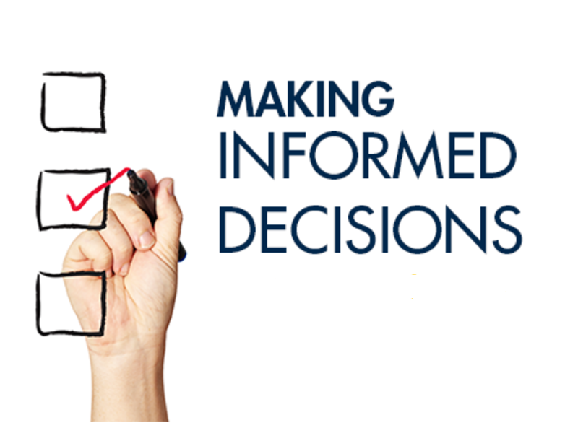
Informed Decision-Making
Data-Driven Insights: When data is organized and analyzed systematically, decision-makers can derive actionable insights based on factual information rather than assumptions or intuition.
This leads to more informed and objective decisions.
Scenario Planning: Organized data enables decision-makers to explore different scenarios and forecast potential outcomes, which can be crucial for risk management and strategic planning.

Slide 16
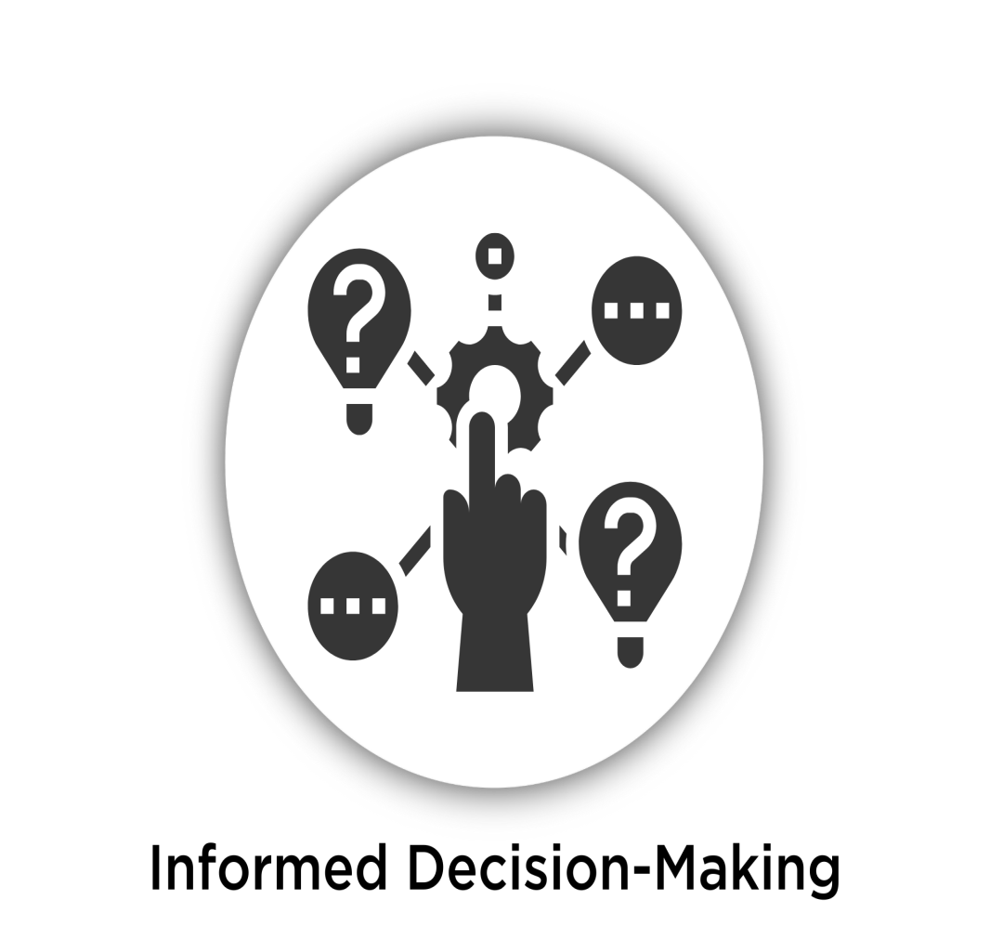
Informed Decision-Making
Shared Understanding: Organized data is easier to share and interpret among teams, leading to better collaboration.
It ensures that all stakeholders are aligned and working with the same information.
Clear Reporting: Organizing data helps in creating clear and concise reports that can be easily understood by various stakeholders, whether they are data analysts, managers, or external partners.

Slide 17
QUESTION 1
When analyzing gathered information, it's crucial to:
Focus solely on confirming your existing assumptions.
Identify key points, patterns, and potential gaps in knowledge.
Ignore any information that contradicts your initial impressions.
Draw conclusions without considering all available data.
Notes:
ANS:B

Slide 18
QUESTION 2
Determining the best course of action after information gathering involves:
Rushing into decisions without considering potential consequences.
Weighing the information, potential risks, and available options.
Relying solely on intuition and gut feeling.
Ignoring expert advice and feedback from colleagues.
Notes:
ANS:B

Slide 19
QUESTION 3
Active listening techniques during information gathering include:
Talking excessively and interrupting the speaker.
Maintaining eye contact, nodding, and asking relevant questions.
Focusing on formulating your response while the other person speaks.
Multitasking and appearing distracted during the conversation.
Notes:
ANS:B

Slide 20
QUESTION 4
When faced with conflicting information, it's important to:
Dismiss any information that contradicts your initial understanding.Ignore the conflicting information and proceed based on assumptions.
Seek clarification, compare sources, and evaluate the credibility of each.
Rely solely on the information that aligns with your desired outcome.
Ignore the conflicting information and proceed based on assumptions.
Notes:
ANS:B

Slide 21
QUESTION 5
Critical thinking skills are essential for:
Accepting information at face value without analysis.
Evaluating the validity, relevance, and potential biases in the information.
Rushing to conclusions based on limited information.
Ignoring the context and circumstances surrounding the information.
Notes:
ANS:B

Slide 22
QUESTION 6
When delegating tasks, it's important to:
Provide unclear instructions and minimal guidance.
Clearly outline the task, expected outcomes, and provide necessary resources.
Micromanage every step of the process.
Delegate without ensuring the individual possesses the necessary skills.
Notes:
ANS:B

Slide 23
QUESTION 7
What is the most effective way to address a situation where you lack crucial information to complete a task?
Fake confidence and proceed without complete information.
Communicate the information gap to the relevant person and seek clarification.
Guess or assume the missing information without verification.
Ignore the lack of information and hope for the best.
Notes:
ANS:B

Slide 24
QUESTION 8
When presenting your findings or recommendations, it's important to:
Focus solely on technical details and jargon without clear explanations.
Tailor your presentation to the audience's level of understanding and highlight key takeaways.
Rush through the presentation without allowing time for questions.
Present the information in a complex and confusing manner.
Notes:
ANS:B

Slide 25
QUESTION 9
When responding to negative feedback, it's crucial to:
Become defensive and deny any wrongdoing.
Acknowledge the feedback, actively listen, and seek solutions for improvement.
Ignore the feedback and continue with your current approach.
Blame others and deflect responsibility for the situation.
Notes:
ANS:B

Slide 26
QUESTION 10
Maintaining a professional online presence involves:
Sharing personal opinions and political views freely on company social media platforms.
Using social media responsibly and avoiding posting anything that could damage your professional reputation or the company's image.
Engaging in online arguments and personal attacks on social media.
Sharing confidential company information publicly online.
Notes:
ANS:D

Slide 27
THANK YOU

